Slide 1

Placental Bioinformatics Course
Dr Russell S. Hamilton
Email: rsh46@cam.ac.uk
Twitter: @drrshamilton
Dr Xiaohui Zhao
Email: xz289@cam.ac.uk
Dr Malwina Prater
Email: mn367@cam.ac.uk
Course Materials:
https://github.com/darogan/2018-PlacentalBiologyCourse
License: Attribution-Non Commercial-Share Alike CC BY-NC-SA ( https://creativecommons.org/licenses/by-nc-sa/ )
Attribution: You must give appropriate credit, provide a link to the license, and indicate if changes were made.
You may do so in any reasonable manner, but not in any way that suggests the licensor endorses you or your use.
NonCommercial: You may not use the material for commercial purposes.
ShareAlike: If you remix, transform, or build upon the material, you must distribute your contributions under the same license as the original.
Version 0.3: 20180705

Slide 2
An introduction to RNA-Seq
Objective for the practical
To learn about how to process, analyse and interpret RNA-Seq data
Learning goals:
Experience using the Linux operating system (Ubuntu)
Learn how to run bioinformatics tools on the command line
Learn how to use R and R-studio
Visualise sequencing alignments in a genome browser
Russell S. Hamilton (rsh46@cam.ac.uk), Xiaohui Zhao (xz289@cam.ac.uk) & Malwina Prater (mn367@cam.ac.uk) 2

Slide 3
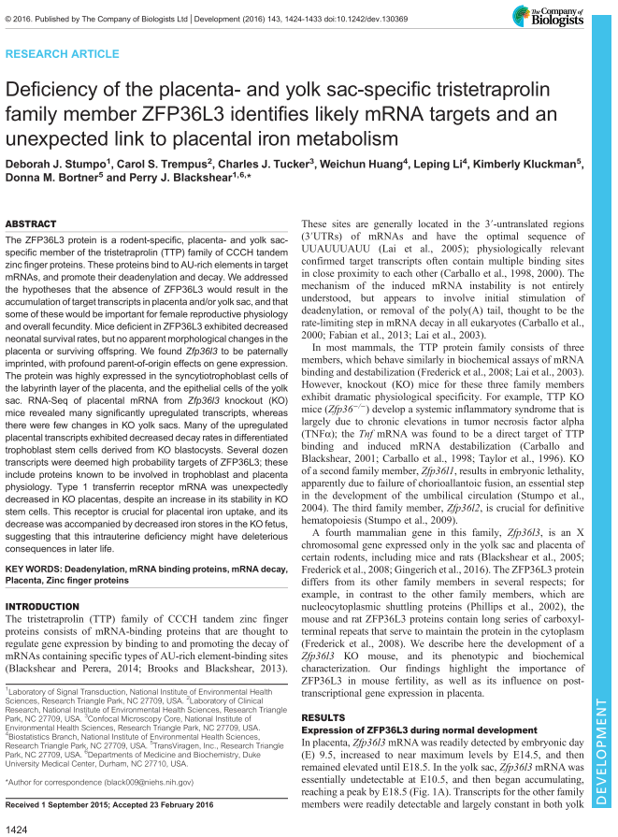
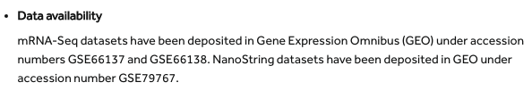
Introduction
RNA-Seq Differential Gene expression between the Placenta and Yolk Sac
Mouse
Bioinformatics Top Tip:
Download fastq files directly from http://www.ebi.ac.uk/ena
Warning:
This is a demo with a reduced data set and parameters,
so take any genes identified with caution
Russell S. Hamilton (rsh46@cam.ac.uk), Xiaohui Zhao (xz289@cam.ac.uk) & Malwina Prater (mn367@cam.ac.uk) 3

Slide 4
Introduction
sample | condition
SRR1811706 | WT Yolk Sac
SRR1811707 | WT Yolk Sac
SRR1811708 | WT Yolk Sac
SRR1811709 | WT Yolk Sac
SRR1823638 | WT Placenta
SRR1823639 | WT Placenta
SRR1823640 | WT Placenta
SRR1823641 | WT Placenta
SRR1823642 | WT Placenta
SRR1823643 | WT Placenta
SRR1823644 | WT Placenta
4x YolkSac
Differentially Expressed Genes / Transcripts
7x Placenta
Russell S. Hamilton (rsh46@cam.ac.uk), Xiaohui Zhao (xz289@cam.ac.uk) & Malwina Prater (mn367@cam.ac.uk) 4

Slide 5
Bioinformatics Pipeline
Sequencing Files (FASTQ) FastQC
Perform quality control (adapter contamination, base quality) trim_galore Command Line
&
Align reads to the genome/transcriptome kallisto FireFox
Summarise QC and alignment metrics MultiQC
Coffee break
Perform differential gene/transcript expression analysis sleuth/DESeq2 R/R-Studio
Visualise sequencing alignments in a genome browser IGV IGV
Look at differentially enriched genes ensEMBL/DAVID Firefox
Russell S. Hamilton (rsh46@cam.ac.uk), Xiaohui Zhao (xz289@cam.ac.uk) & Malwina Prater (mn367@cam.ac.uk) 5

Slide 6

Using the Bioinformatics Training Facility Computers
Finder / Windows Explorer
Terminal
Course_Materials / PlacentalBioCourse
Firefox
IGV
R-Studio
To open this presentation double-click
2018_PlacentalBiologyCourse_Presentation.pdf
Linux ::: Ubuntu
Russell S. Hamilton (rsh46@cam.ac.uk), Xiaohui Zhao (xz289@cam.ac.uk) & Malwina Prater (mn367@cam.ac.uk) 6

Slide 7
Files
2018_PlacentalBiologyCourse.pptx
2018_PlacentalBiologyCourse.pdf
2018_PlacentalBiologyCourse_Sleuth.Rmd
2018_PlacentalBiologyCourse_commands.txt
stumpo_2016_Development.pdf
SRR1811706_ES610_WT_Yolk_Sac/
SRR1811707_ES611_WT_Yolk_Sac/
SRR1811708_ES612_WT_Yolk_Sac/
SRR1811709_ES613_WT_Yolk_Sac/
SRR1823638_ES51_WT_Placenta/
SRR1823639_ES51_WT_Placenta/
SRR1823640_ES52_WT_Placenta/
SRR1823641_ES52_WT_Placenta/
SRR1823642_ES53_WT_Placenta/
SRR1823643_ES54_WT_Placenta/
SRR1823644_ES55_WT_Placenta/
IGV_Alignments/
ENST_ENSG_GeneName.GRCm38.kallisto.table
Mus_musculus.GRCm38.cdna.all.idx
SRR1823638_sub_1.fastq.gz
SRR1823638_sub_2.fastq.gz
Course Materials
SRR1823638 Sequencing Data
SRR1823638_1.fastq.gz_trimming_report.txt
SRR1823638_1_fastqc.html
SRR1823638_1_fastqc.zip
SRR1823638_1_val_1.fq.gz_kallisto_output/
SRR1823638_1_val_1_fastqc.html
SRR1823638_1_val_1_fastqc.zip
SRR1823638_2.fastq.gz_trimming_report.txt
SRR1823638_2_fastqc.html
SRR1823638_2_fastqc.zip
SRR1823638_2_val_2_fastqc.html
SRR1823638_2_val_2_fastqc.zip
Publication
Kallisto Output
abundance.h5
abundance.tsv
run_info.json
Sample Data
Placenta_SRR1823638_kallisto.bam
Placenta_SRR1823638_kallisto.bam.bai
YolkSac_SRR1811706_kallisto.bam
YolkSac_SRR1811706_kallisto.bam.bai
Alignments (Premade)
Reference Genome
Reference Genome
Subset of real data for this practical 1M reads only (~10%)
Russell S. Hamilton (rsh46@cam.ac.uk), Xiaohui Zhao (xz289@cam.ac.uk) & Malwina Prater (mn367@cam.ac.uk) 7

Slide 8
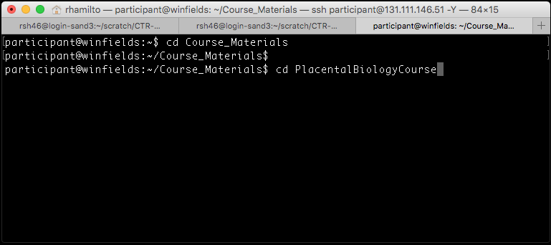
Using the Bioinformatics Training Facility Computers
Bioinformatics Top Tip:
More Linux Commands
ls list files in directory
cd ~ change back to home
directory
tree view files and
directories in a
hierarchical structure
history view a list of the most
recent commands used
Caution!
Commands are case sensitive
Take care to correctly specify spaces and flags (dashes)
Terminal
change directory
Directory name
$ cd Course_Materials
$ cd PlacentalBioCourse
Russell S. Hamilton (rsh46@cam.ac.uk), Xiaohui Zhao (xz289@cam.ac.uk) & Malwina Prater (mn367@cam.ac.uk) 8

Slide 9
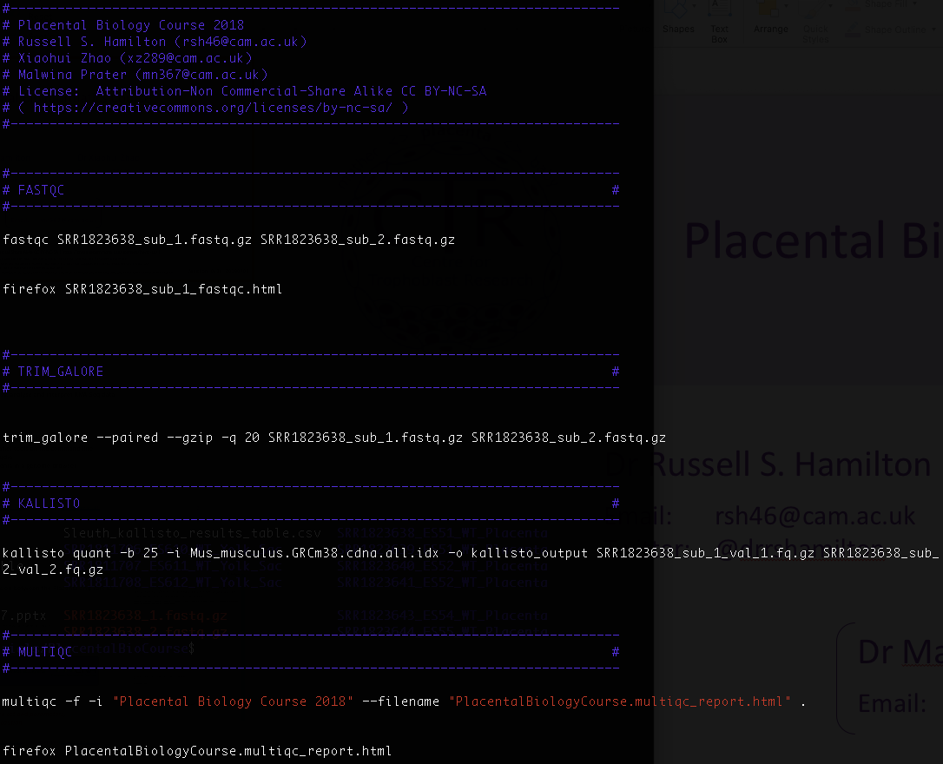
Command Line
Copy & Paste from PDF or Powerpoint to the command line doesn’t always work as expected
2018_PlacentalBiologyCourse_Commands.txt
Russell S. Hamilton (rsh46@cam.ac.uk), Xiaohui Zhao (xz289@cam.ac.uk) & Malwina Prater (mn367@cam.ac.uk) 9

Slide 10
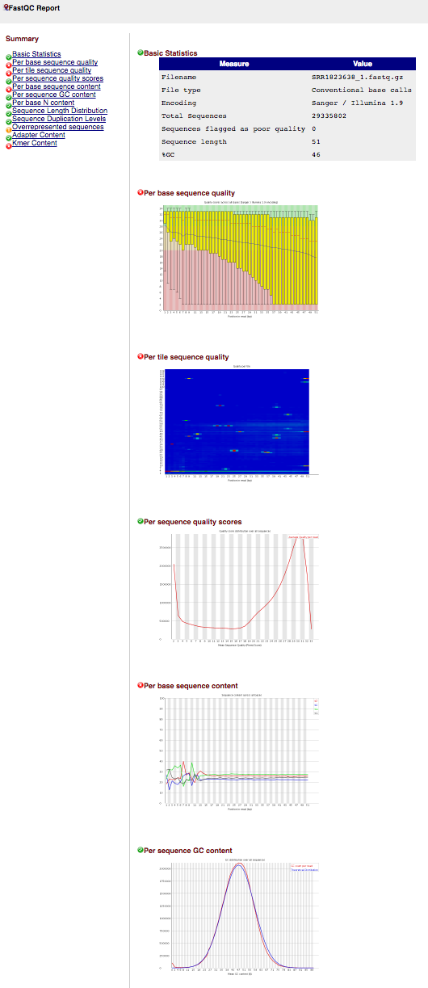
FastQC
FastQC A quality control tool for high throughput sequence data
Version 0.11.5
Download http://www.bioinformatics.babraham.ac.uk/projects/fastqc/
Terminal:
$ fastqc SRR1823638_sub_1.fastq.gz SRR1823638_sub_2.fastq.gz
$ firefox SRR1823638_sub_1_fastqc.html
Output:
HTML Reports Archive of data/images
SRR1823638_sub_1_fastqc.html SRR1823638_sub_1_fastqc.zip
SRR1823638_sub_2_fastqc.html SRR1823638_sub_2_fastqc.zip
Read 1
Read 2
Bioinformatics Top Tip: Simon Andrews’ https://sequencing.qcfail.com/
Russell S. Hamilton (rsh46@cam.ac.uk), Xiaohui Zhao (xz289@cam.ac.uk) & Malwina Prater (mn367@cam.ac.uk) 10

Slide 11
trim_galore
trim_galore A wrapper tool around Cutadapt to consistently apply quality and adapter trimming to FastQ files
Version 0.4.4
Download http://www.bioinformatics.babraham.ac.uk/projects/trim_galore/
Terminal:
$ trim_galore --paired --gzip -q 20 SRR1823638_sub_1.fastq.gz SRR1823638_sub_2.fastq.gz
Output:
Trimmed Fastq files
SRR1823638_sub_1_val_1.fq.gz
SRR1823638_sub_2_val_2.fq.gz
Compress the output fastq files
Read 1
Read 2
Tread as paired-end
Quality score threshold (PHRED > 20)
Russell S. Hamilton (rsh46@cam.ac.uk), Xiaohui Zhao (xz289@cam.ac.uk) & Malwina Prater (mn367@cam.ac.uk) 11

Slide 12
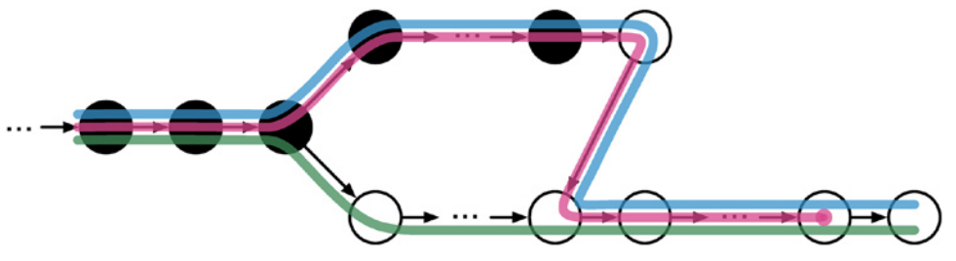
Alignment: STAR Vs Kallisto
STAR: Align to genome
Kallisto: Align to transcriptome
Exon 1
Exon 2
✓
Exon 1
Exon 2
✓
Single exon mapping
✓
Exon 1
Exon 2
✗
Multi-exon reads
Reads divided into segments
splice site identified
✗
Exon 1
Exon 2
✓
Segments aligned and assembled
 | STAR | Kallisto
Run time | hours | minutes
Hardware requirements | Multi-core | Laptop
Novel Splice Sites | yes | no
Russell S. Hamilton (rsh46@cam.ac.uk), Xiaohui Zhao (xz289@cam.ac.uk) & Malwina Prater (mn367@cam.ac.uk) 12

Slide 13
kallisto
kallisto Program for quantifying abundances of transcripts from RNA-Seq data, without the need for alignment
Version 0.43.1
Download https://pachterlab.github.io/kallisto
Terminal:
$ kallisto quant -b 25 -i Mus_musculus.GRCm38.cdna.all.idx
-o kallisto_output SRR1823638_sub_1_val_1.fq.gz SRR1823638_sub_2_val_2.fq.gz
Output:
kallisto_output/
abundance.h5
abundance.tsv
run_info.json
Number of bootstraps
Indexed transcriptome
Output directory
Trimmed Read 1
Trimmed Read 2
Note command must be all on one single line
Russell S. Hamilton (rsh46@cam.ac.uk), Xiaohui Zhao (xz289@cam.ac.uk) & Malwina Prater (mn367@cam.ac.uk) 13

Slide 14
RNA-Seq Mapping Metrics: Counts Vs FPKM Vs TPM
Counts
The number of reads mapping to a transcript or gene
Longer transcripts will generally have more mapped reads
FPKM (Fragments Per Kilobase of transcript per Million mapped reads)
Normalises the counts for the length of the transcript
TPM (Transcripts Per Million)
Measurement of the proportion of transcripts in your pool of RNA
None of these are for comparing across samples
Sample normalisation required as performed by DESeq2 and Sleuth
Russell S. Hamilton (rsh46@cam.ac.uk), Xiaohui Zhao (xz289@cam.ac.uk) & Malwina Prater (mn367@cam.ac.uk) 14

Slide 15
MultiQC
MultiQC Aggregate results from bioinformatics analyses across many samples into a single report
Version 1.1dev
Download http://multiqc.info/
Terminal:
$ multiqc -f -i "Placental Biology Course 2018"
--filename ”PlacentalBiologyCourse.multiqc_report.html" .
$ firefox PlacentalBiologyCourse.multiqc_report.html
Output:
HTML Report
PlacentalBiologyCourse.multiqc_report.html
PlacentalBiologyCourse.multiqc_report_data
Overwrite existing report
A title for your report
Output filename
“.” Is a special Linux symbol which means the current directory
Russell S. Hamilton (rsh46@cam.ac.uk), Xiaohui Zhao (xz289@cam.ac.uk) & Malwina Prater (mn367@cam.ac.uk) 15

Slide 16
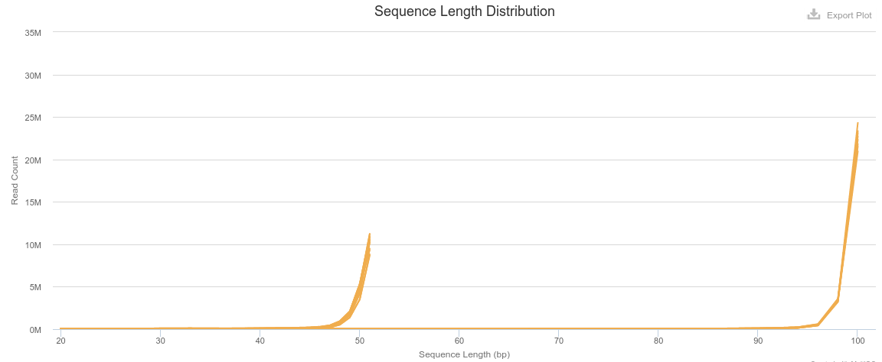
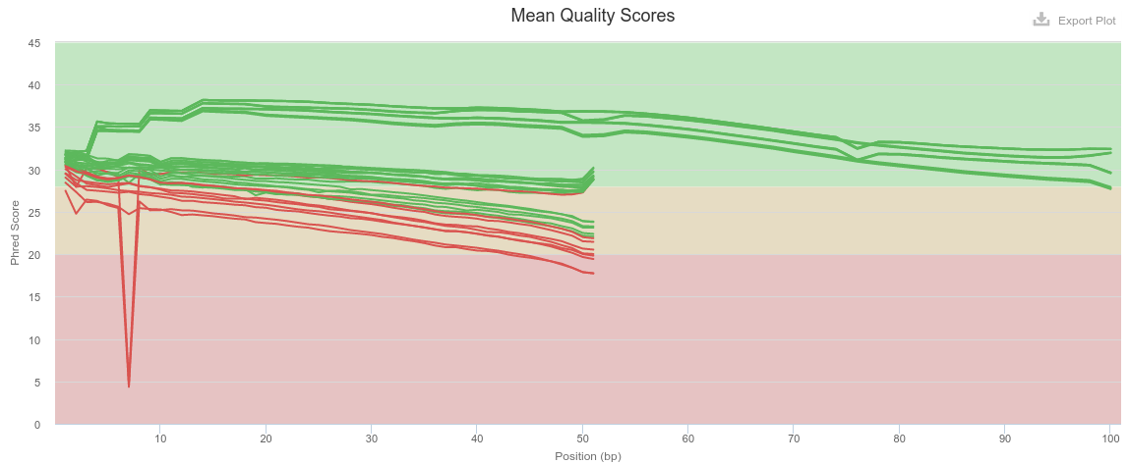
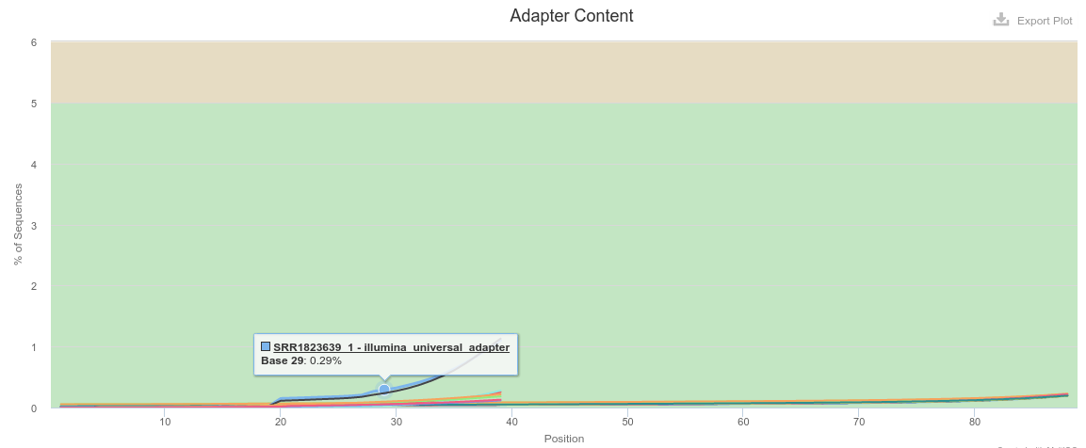
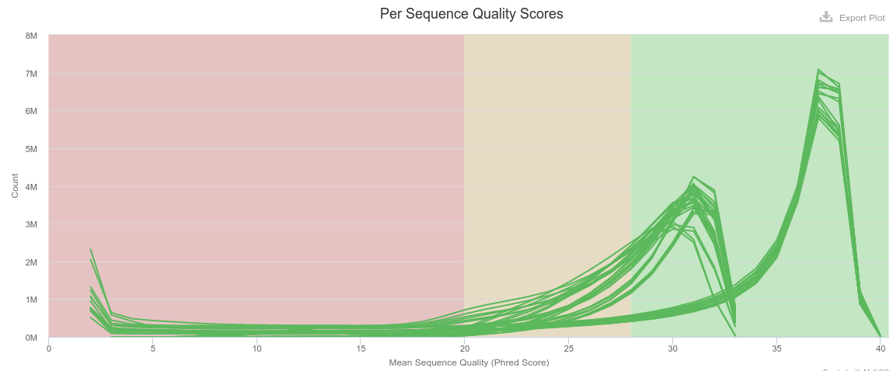
QC Fastq Files
Batch effects
Sample groups have different read lengths
Some Placenta samples have low quality scores
Yolk sac
Placenta
There are adapters in both sample groups
Placenta
Yolk sac
Russell S. Hamilton (rsh46@cam.ac.uk), Xiaohui Zhao (xz289@cam.ac.uk) & Malwina Prater (mn367@cam.ac.uk) 16

Slide 17
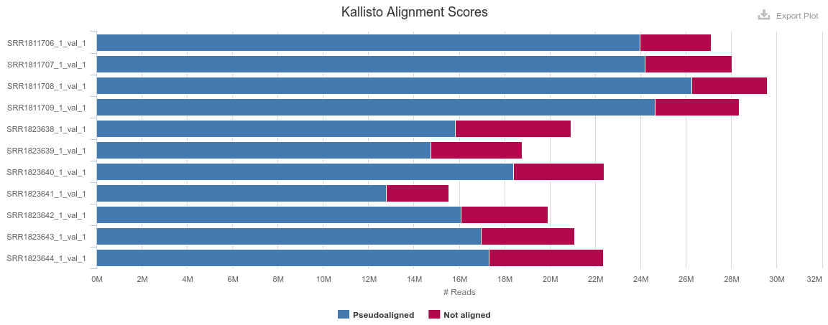
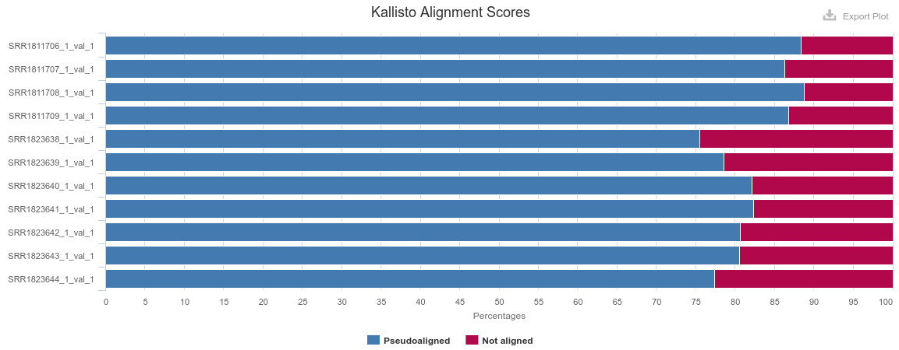
QC Alignments
Why do you never see 100% alignment?
Incomplete reference genomes / transcriptomes
Repetitive reads hard to map uniquely
Sample: Structural Variants
Copy Number Variants
Yolk Sac
Placenta
Yolk Sac
Harsher trimming, more reads removed / trimmed
Placenta
Russell S. Hamilton (rsh46@cam.ac.uk), Xiaohui Zhao (xz289@cam.ac.uk) & Malwina Prater (mn367@cam.ac.uk) 17

Slide 18
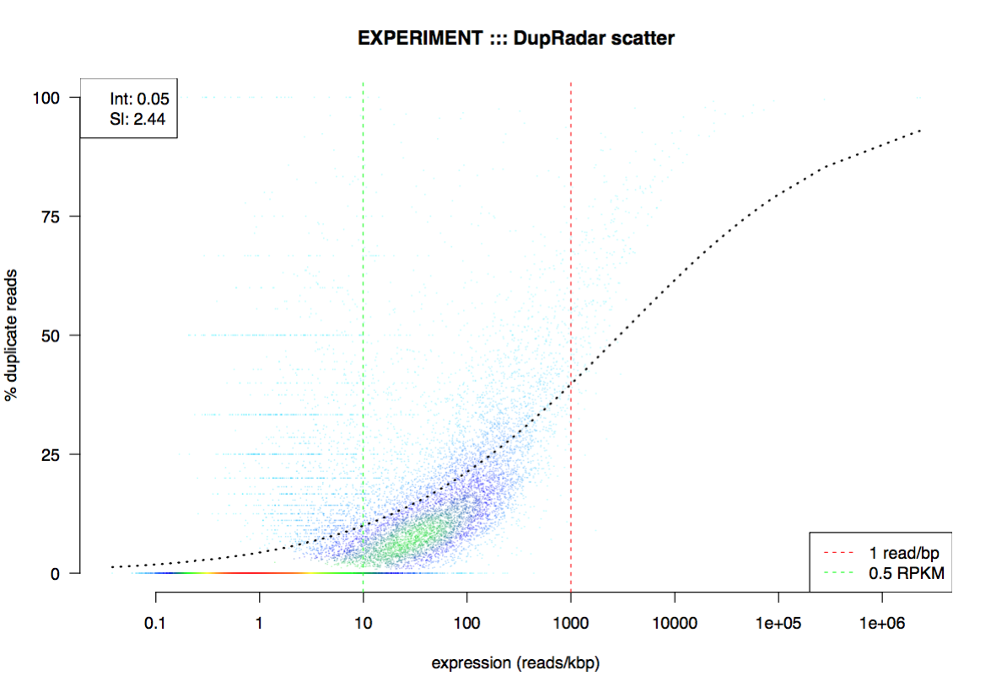
Further QC
rRNA and mt content
dupRadar
Custom Plots
Batch effect correction
e.g. Two sequencing experiments performed on different days by two different people
Batch effect removal:
Limma / Combat
Use batch in comparison in DESeq2 design
~ batch + condition
Russell S. Hamilton (rsh46@cam.ac.uk), Xiaohui Zhao (xz289@cam.ac.uk) & Malwina Prater (mn367@cam.ac.uk) 18

Slide 19
Coffee Break
Part 1. Quality control, alignment and transcript quantification
Part 2. Differential Expression Analysis
Russell S. Hamilton (rsh46@cam.ac.uk), Xiaohui Zhao (xz289@cam.ac.uk) & Malwina Prater (mn367@cam.ac.uk) 19

Slide 20
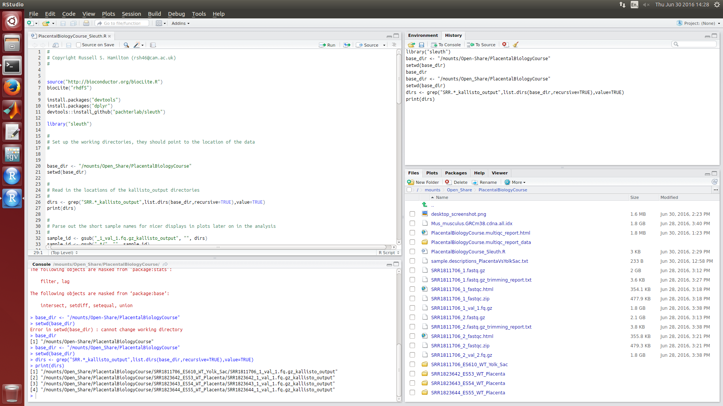
Sleuth
sleuth Analysis of RNA-Seq experiments for which transcript abundances have been quantified with kallisto
Version 0.28.1
Download http://pachterlab.github.io/sleuth/
R
A statistical programming language
R-Studio, a graphical environment for using R
# denotes a comment
R-Studio
3. Run
2. Put cursor on line you want to run
1. File ::: Open File ::: PlacentalBiologyCourse_Sleuth.Rmd
Russell S. Hamilton (rsh46@cam.ac.uk), Xiaohui Zhao (xz289@cam.ac.uk) & Malwina Prater (mn367@cam.ac.uk) 20

Slide 21
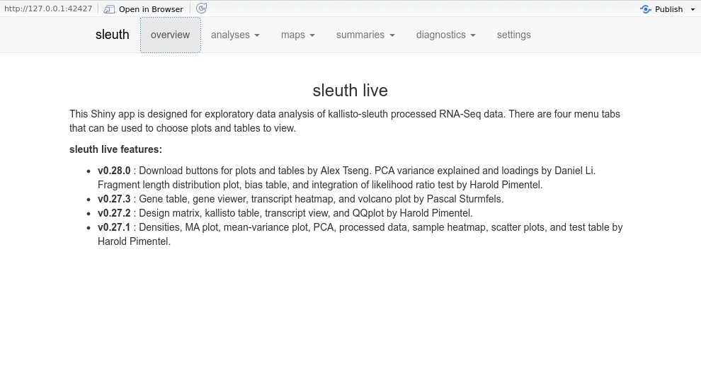
Sleuth/R:shiny
Click here if you prefer to view the results in firefox
First look at the PCA and heatmap clustering plots
Do the samples cluster by Yolk sac and placenta?
Russell S. Hamilton (rsh46@cam.ac.uk), Xiaohui Zhao (xz289@cam.ac.uk) & Malwina Prater (mn367@cam.ac.uk) 21

Slide 22
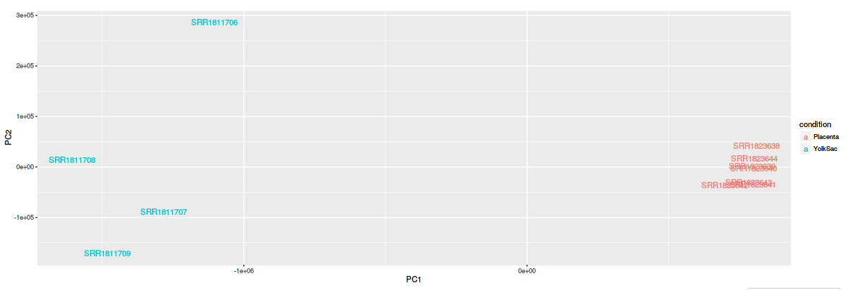
Sample Clustering
PCA Plot
Yolk sac
Placenta
Placenta
Heat Map
Yolk sac
Russell S. Hamilton (rsh46@cam.ac.uk), Xiaohui Zhao (xz289@cam.ac.uk) & Malwina Prater (mn367@cam.ac.uk) 22

Slide 23
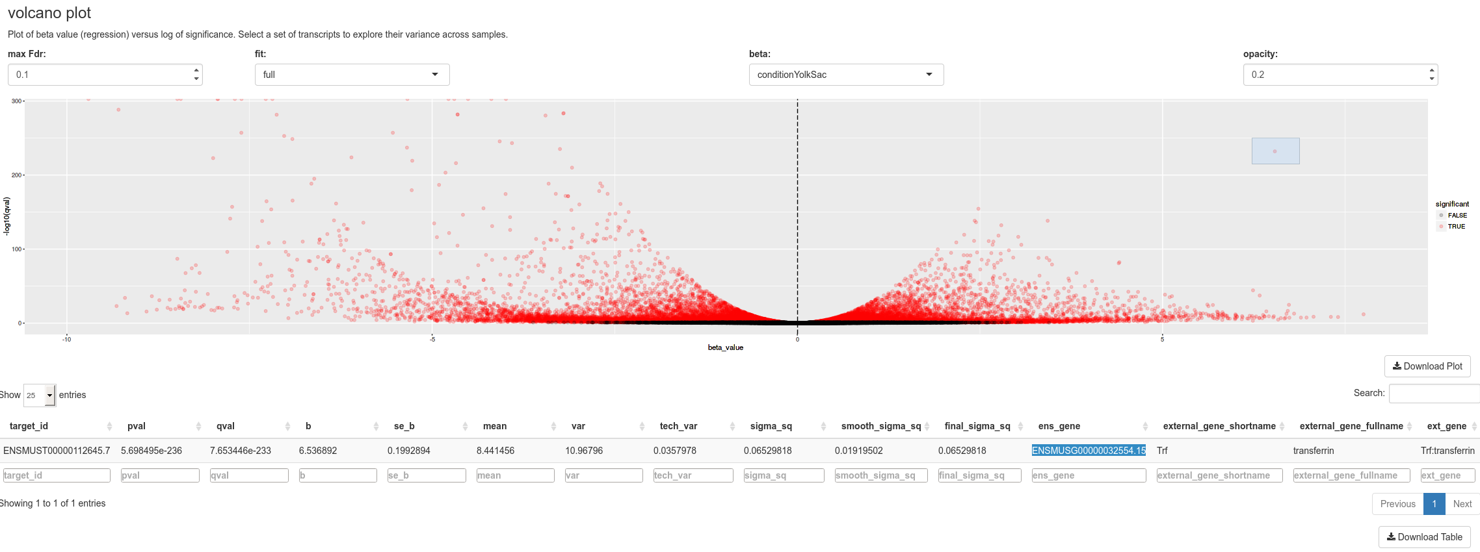
Volcano Plot
Select point or group of points
= differentially expressed transcripts
Expressed more in Placenta than Yolk Sac
Expressed more in Yolk Sac than Placenta
Russell S. Hamilton (rsh46@cam.ac.uk), Xiaohui Zhao (xz289@cam.ac.uk) & Malwina Prater (mn367@cam.ac.uk) 23

Slide 24
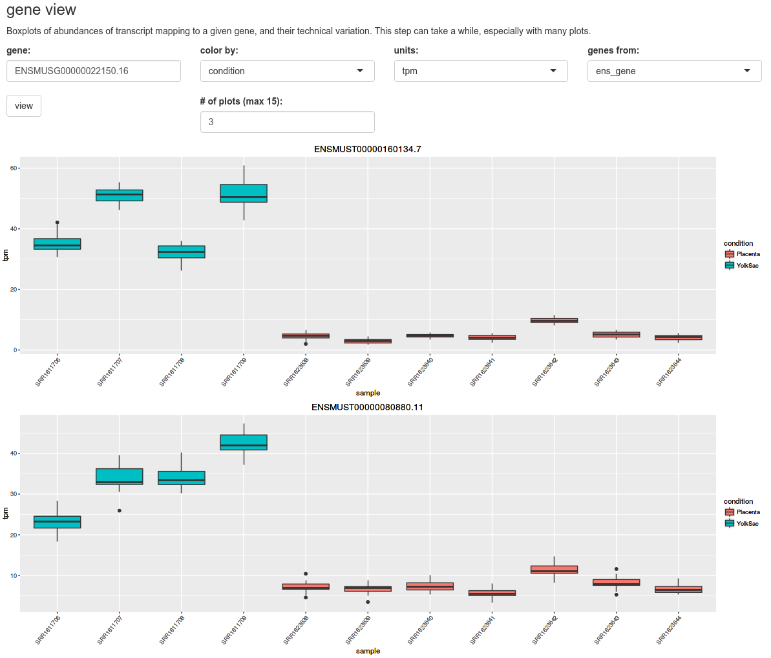
Differentially Expressed Genes
Select TPM
Transcripts Per Million
Select external_
gene_ shortname
Paste an external gene shortname here
Yolk sac
Placenta
Russell S. Hamilton (rsh46@cam.ac.uk), Xiaohui Zhao (xz289@cam.ac.uk) & Malwina Prater (mn367@cam.ac.uk) 24

Slide 25
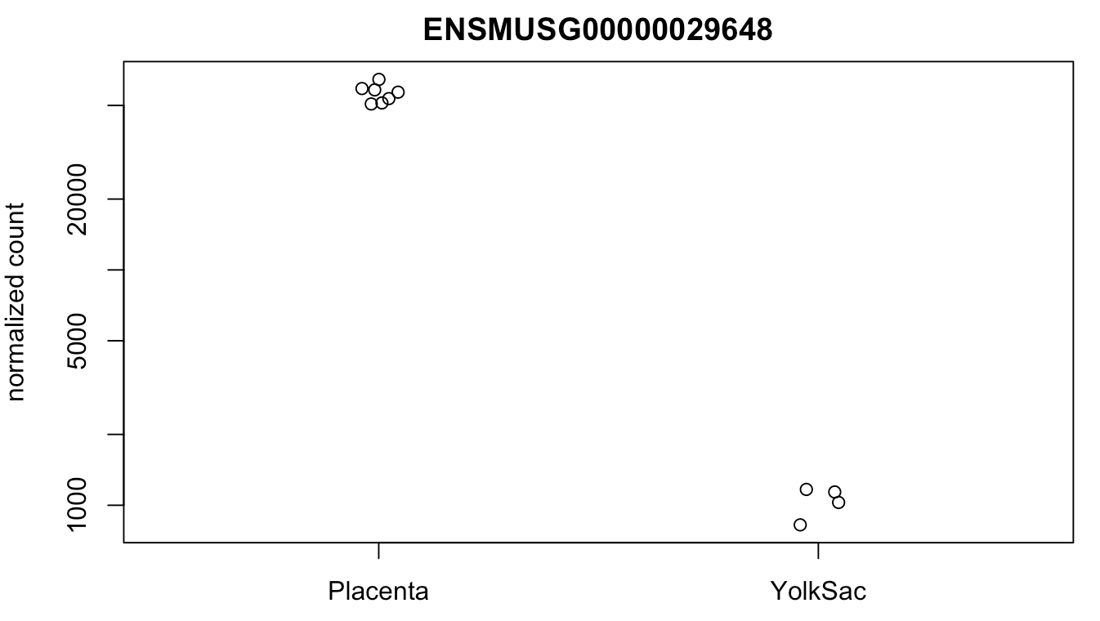
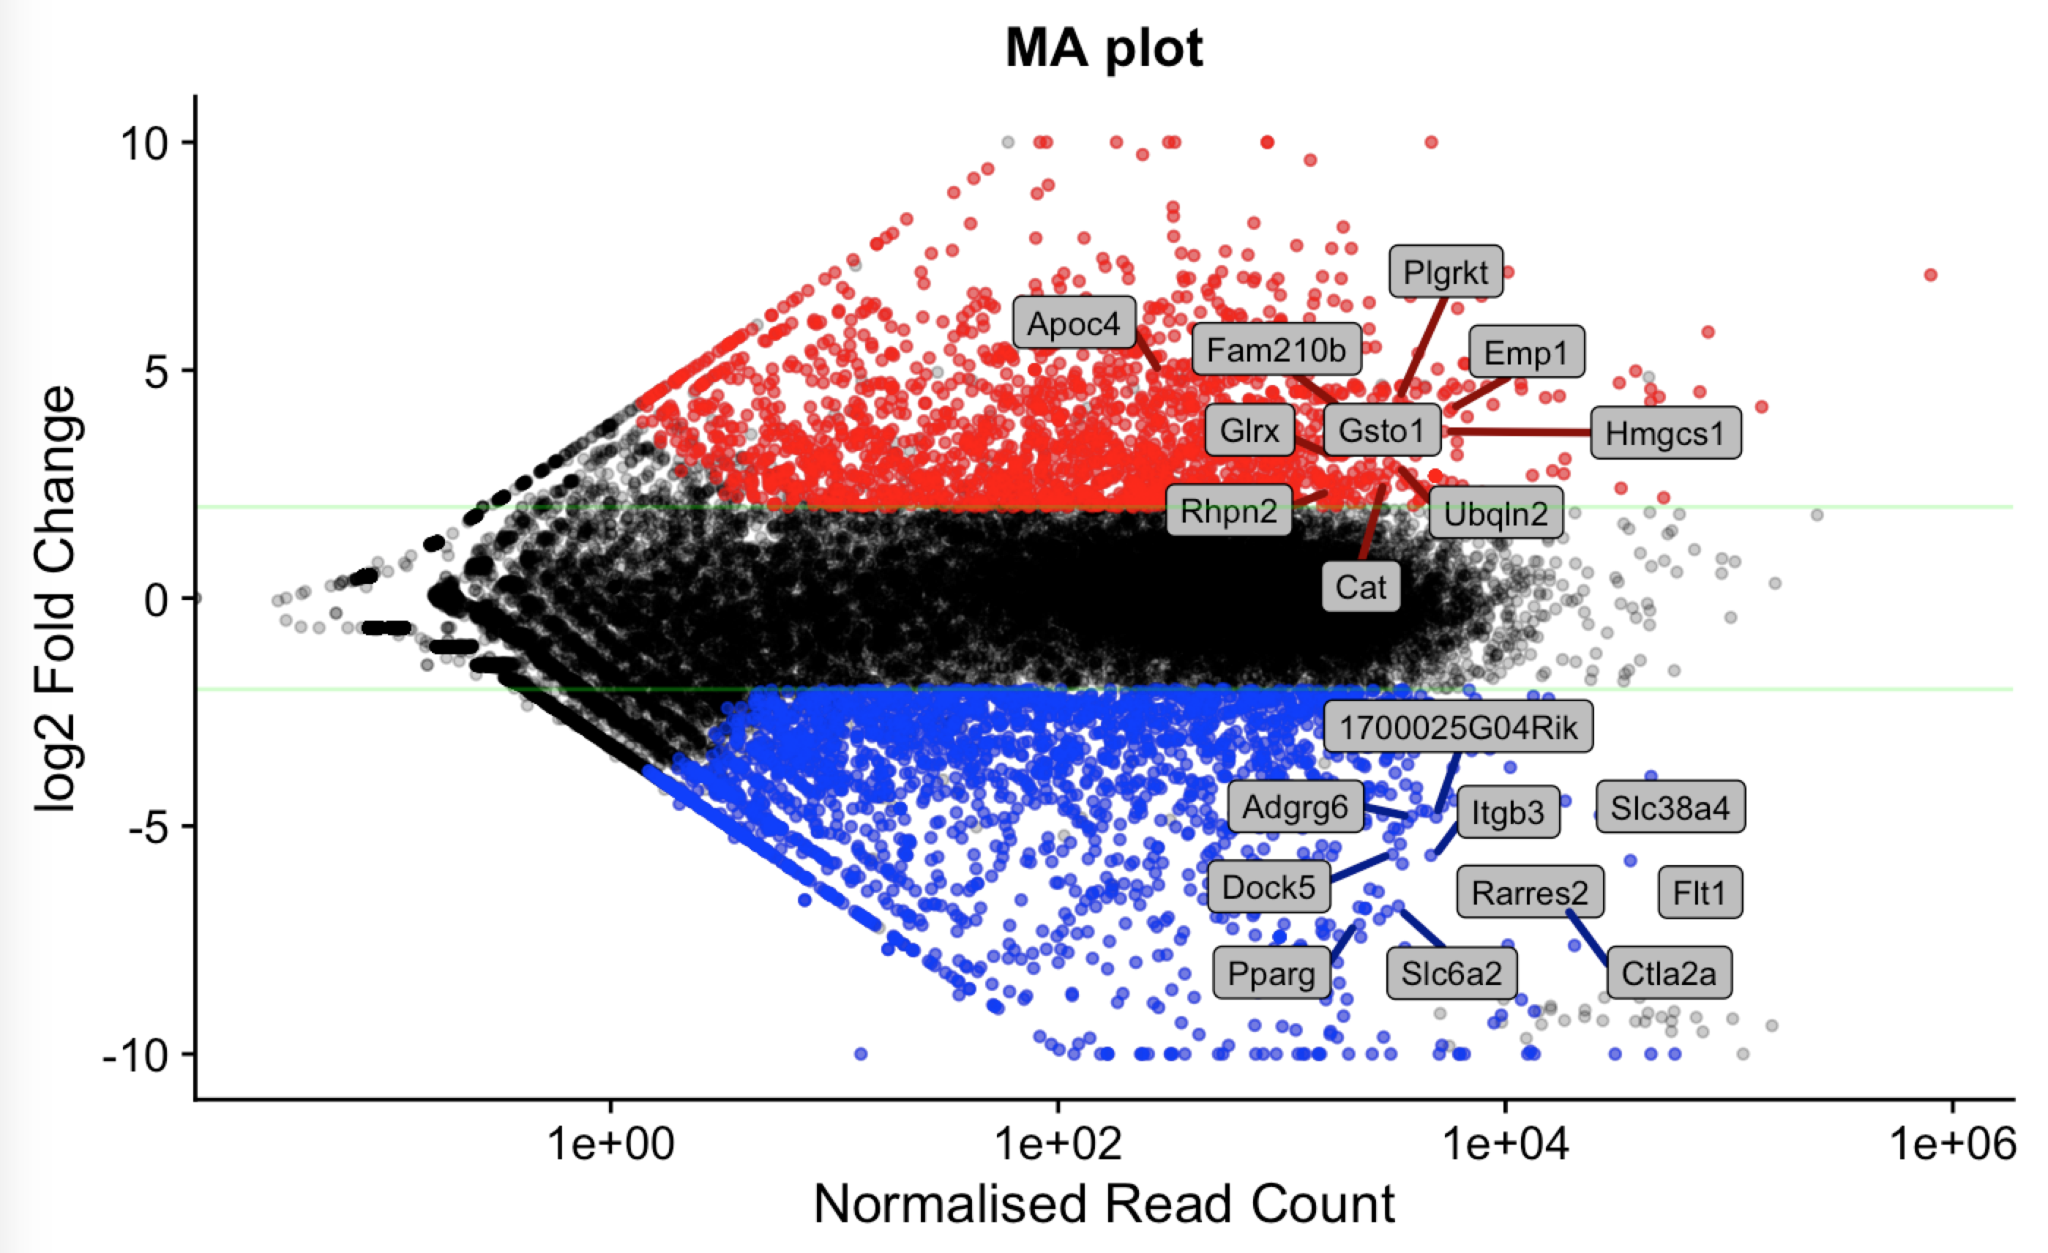
i
DESeq2
DESeq2 Package For Differential Analysis Of Count Data
From global picture to individual genes
Russell S. Hamilton (rsh46@cam.ac.uk), Xiaohui Zhao (xz289@cam.ac.uk) & Malwina Prater (mn367@cam.ac.uk) 25

Slide 26
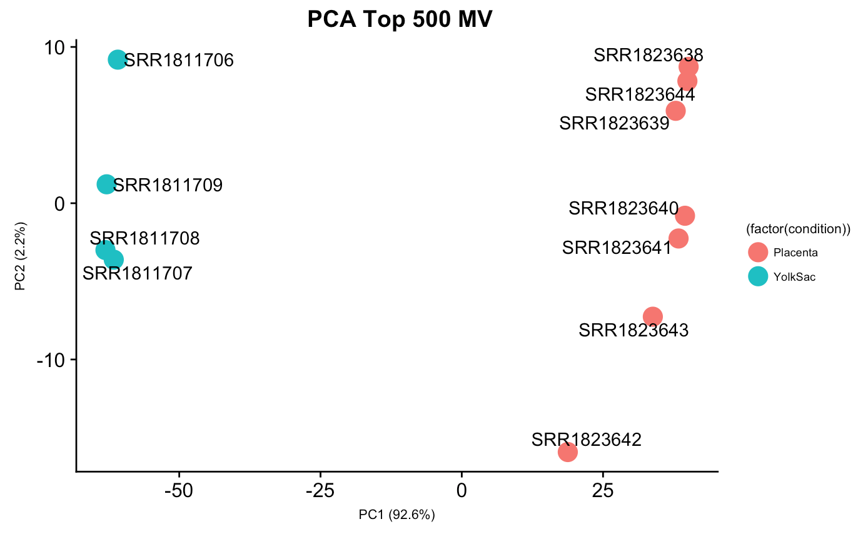
DESeq2: PCA
Similar to the Sleuth version, but you can customise number of genes to use, colour, labels etc much more easily using the DESeq2/ggplot custom version
Russell S. Hamilton (rsh46@cam.ac.uk), Xiaohui Zhao (xz289@cam.ac.uk) & Malwina Prater (mn367@cam.ac.uk) 26

Slide 27
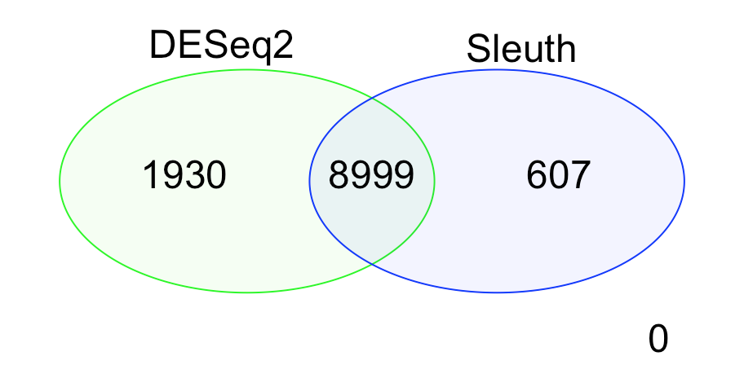
Differentially Expressed Genes
Differentially Expressed Genes found only by Sleuth
Differentially Expressed Genes found only by DESeq2
Common Differentially Expressed Genes
DESeq2 is consider to perform better at a gene level
Sleuth performs better on a transcript level
Better for identifying alternatively spliced isoform usage
Russell S. Hamilton (rsh46@cam.ac.uk), Xiaohui Zhao (xz289@cam.ac.uk) & Malwina Prater (mn367@cam.ac.uk) 27

Slide 28
Looking at the Alignments
File
Load From File…
IGV_Alignments/
Placenta_SRR1823638_kallisto.bam
Placenta_SRR1823638_kallisto.bam.bai
YolkSac_SRR1811706_kallisto.bam
YolkSac_SRR1811706_kallisto.bam.bai
Select: Mouse(mm10)
Search for Flt1
Can you see the difference in coverage?
Russell S. Hamilton (rsh46@cam.ac.uk), Xiaohui Zhao (xz289@cam.ac.uk) & Malwina Prater (mn367@cam.ac.uk) 28

Slide 29
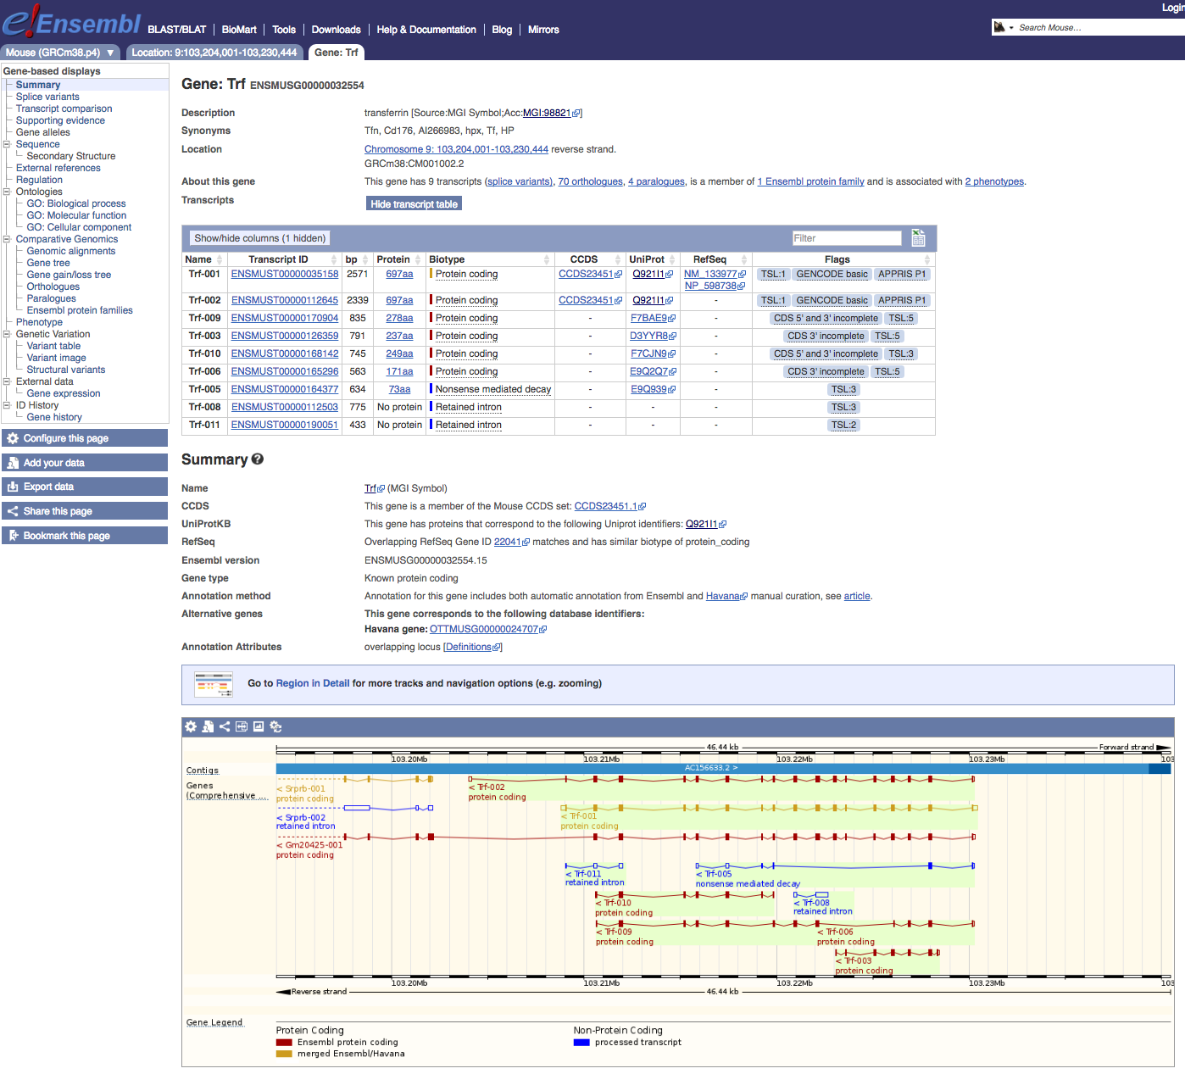
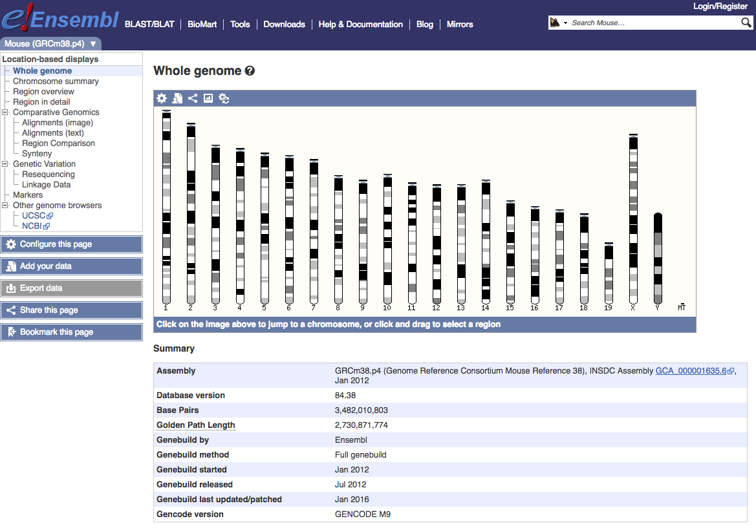
ensEMBL
http://www.ensembl.org/Mus_musculus/Location/Genome
Enter gene to search here
e.g. Trf
What is the function of Trf?
Russell S. Hamilton (rsh46@cam.ac.uk), Xiaohui Zhao (xz289@cam.ac.uk) & Malwina Prater (mn367@cam.ac.uk) 29

Slide 30
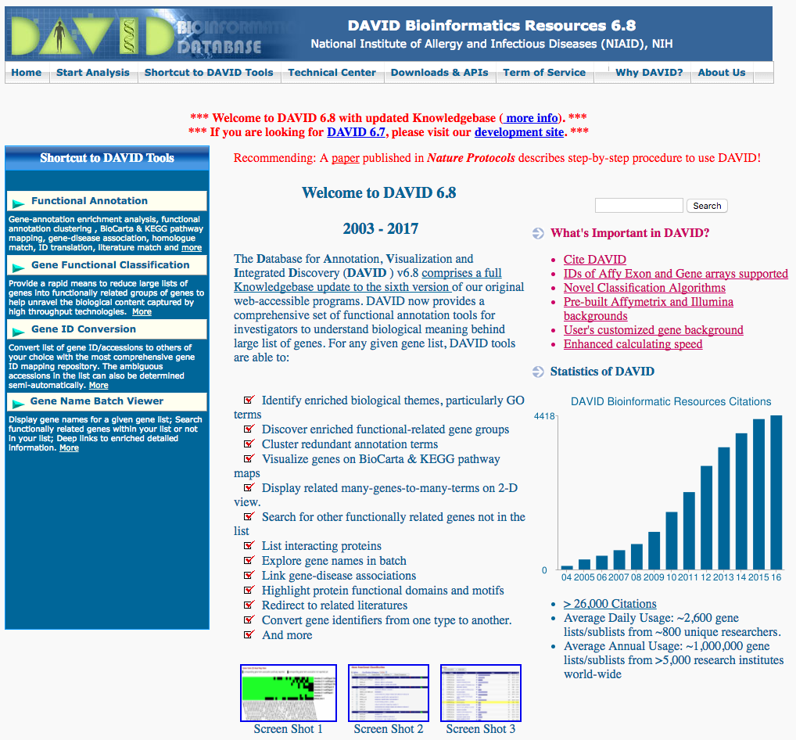
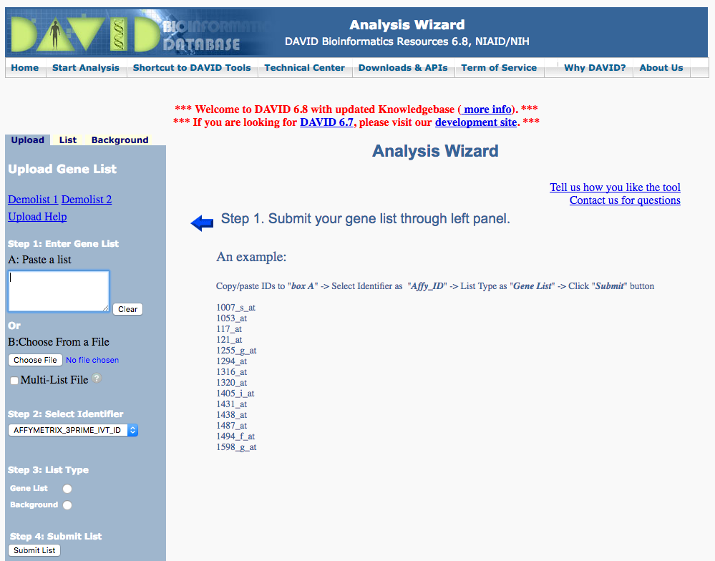
DAVID Gene Ontology Analysis
https://david.ncifcrf.gov/
Paste List of ensEMBL gene identifiers
Start Analysis
Select gene list and GO!
Russell S. Hamilton (rsh46@cam.ac.uk), Xiaohui Zhao (xz289@cam.ac.uk) & Malwina Prater (mn367@cam.ac.uk) 30

Slide 31
Reproducible Bioinformatics
Versioning
If you write code or scripts use a versioning system (a bit like track changes in Word)
Make it publicly available so people can comment and submit bug reports
e.g. http://www.github.com
Pipelines
Track program version numbers, consistent processing and reporting
Avoid manual input of data or settings
e.g. http://custerflow.io or SnakeMake
Data Repositories
Upload your published data to GEO, ENA, SRA etc
Russell S. Hamilton (rsh46@cam.ac.uk), Xiaohui Zhao (xz289@cam.ac.uk) & Malwina Prater (mn367@cam.ac.uk) 31

Slide 32
Dr Russell S. Hamilton
Email: rsh46@cam.ac.uk
Dr Xiaohui Zhao
Email: xz289@cam.ac.uk
Dr Malwina Prater
Email: mn367@cam.ac.uk
Course Materials:
https://github.com/darogan/2018-PlacentalBiologyCourse
License: Attribution-Non Commercial-Share Alike CC BY-NC-SA ( https://creativecommons.org/licenses/by-nc-sa/ )
Attribution: You must give appropriate credit, provide a link to the license, and indicate if changes were made.
You may do so in any reasonable manner, but not in any way that suggests the licensor endorses you or your use.
NonCommercial: You may not use the material for commercial purposes.
ShareAlike: If you remix, transform, or build upon the material, you must distribute your contributions under the same license as the original.

